Slide 1
COMMUNICATION AND ITS FORMS

Slide 2
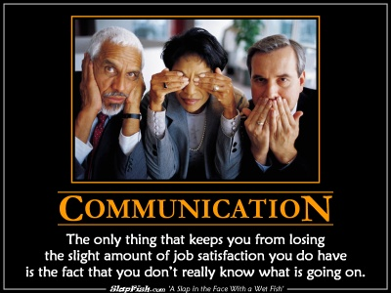
Communication - definition
the process by which people exchange information or express their thoughts and feelings

Slide 3

VERBAL – NON-VERBAL
verbal
1. spoken rather than written
2. relating to words or using words
3. relating to a verb

Slide 4
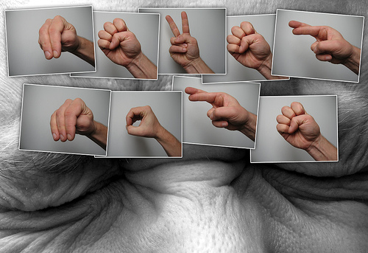
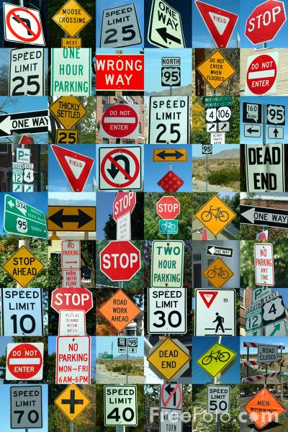
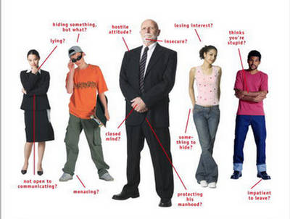
non-verbal

Slide 5
Verbal communication
Oral (spoken)
1. face to face
(interaction, gestures, facial expressions, voice,tone, fillers, pauses,laughter, sighs,repetition,
hesitation,
explanation, simple, spontaneous,cannot be taken back)
formal /informal
2. on the phone
(speaker´s body language is not seen)

Slide 6
Verbal communication
Written
1. formal letters, texts, emails
(more complicated, more formal, requires planning and more time, structured, precise choice of words, can be reread, stored, editted,one-way)
2. Informal letters, text messages, emails, chat
(less complicated, less formal, spontaneous, punctuation, pictures, smiles, chat – immediate feedback)

Slide 7
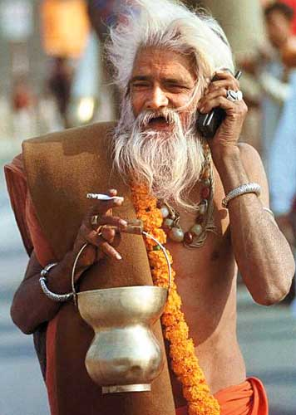


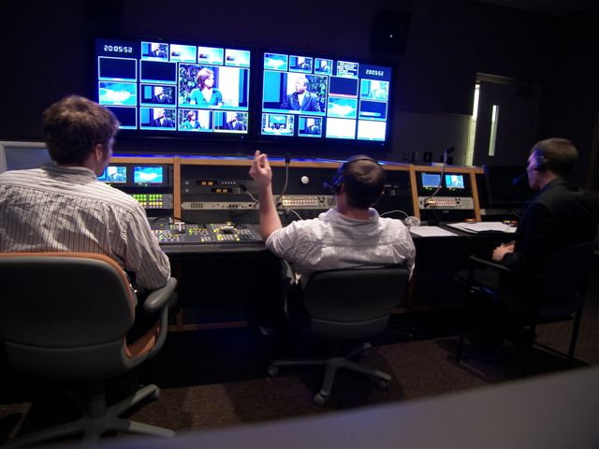
Communication and new technologies

Slide 8

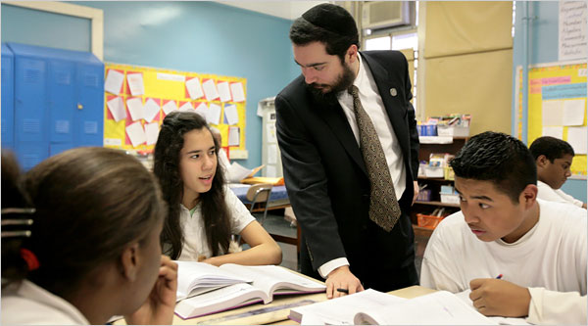
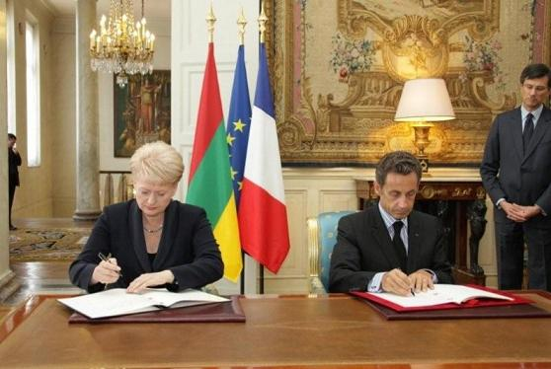
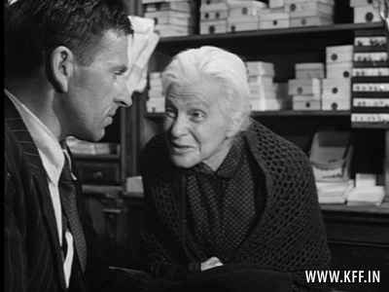
Communication in different situations

Slide 9
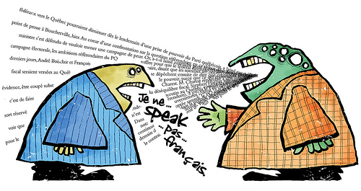
Communication and languages
Esperanto
English
EU
taught at school
get to know other culture
business
self-confidence

Slide 10
